Slide 1

Worldwide Sentiment Analysis of Large Language Models (LLMs)
Course: DAAN 545 – Data Mining (Fall 2025)
Team: Tushar • Saakshaat Saini • Julien Hill
Date: October 13 2025

Slide 2
Problem Statement & Objective
Goal
Goal: Equip AI policymakers with actionable insights by examining global sentiment toward LLMs.
Visualize
Visualize sentiment trends across regions.
Identify
Identify emerging narratives and issues.
Establish
Establish alert systems when negative sentiment exceeds thresholds.

Slide 3
Importance of Research
Understanding public sentiment is critical for responsible AI governance.
Policymakers: Build region-specific AI ethics and safety frameworks.
Researchers: Track cross-cultural adoption and innovation patterns.
Society: Encourage transparency and accountability.
Healthcare: Detect and prevent AI-induced psychosis or distress.

Slide 4
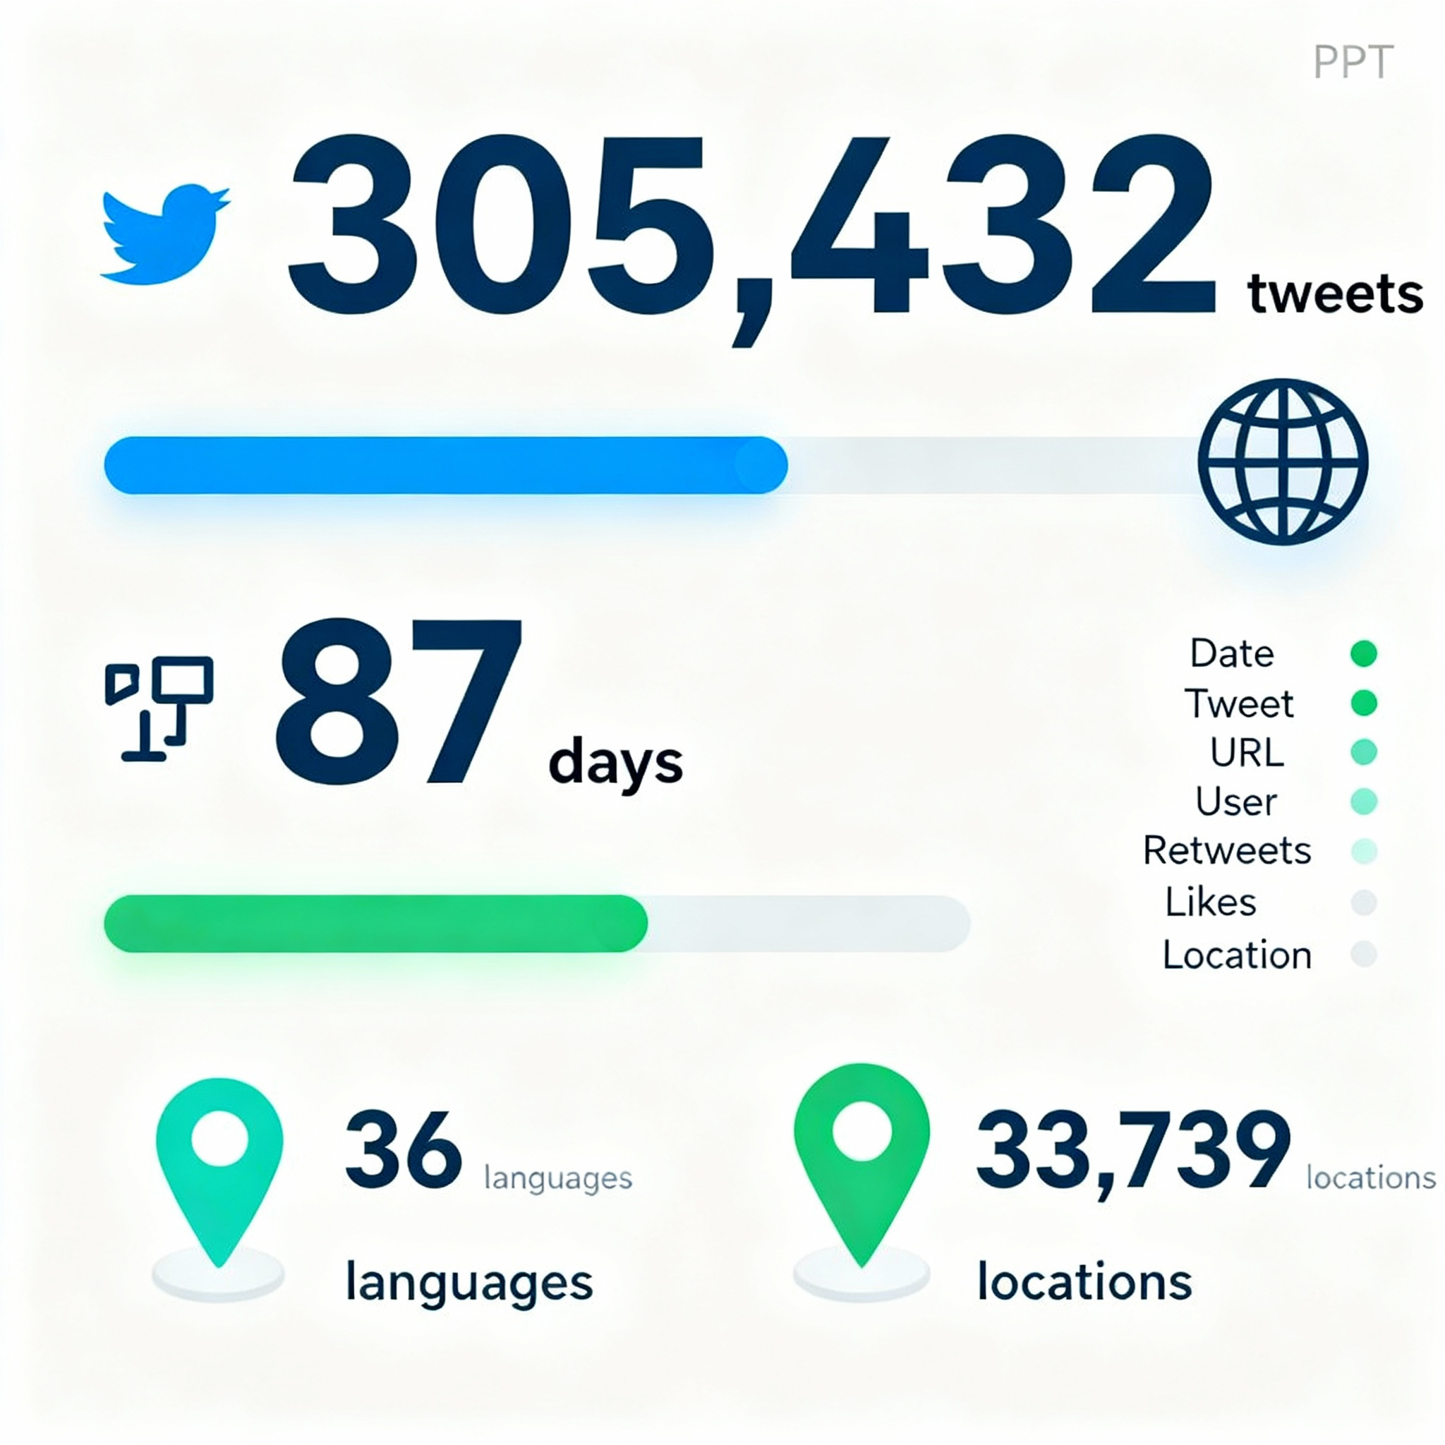
Dataset Overview
305,432 tweets collected from Twitter/X.
Covers 87 days (Nov 30 2022 – Feb 24 2023).
36 languages, 33,739 unique locations.
Key variables: Date, Tweet, URL, User Info, Retweets, Likes, Location

Slide 5

Data Collection Criteria
Keywords: ChatGPT, LLM, GPT, Bard, etc.
Ensured diversity in geography and engagement.
Focused on authentic, human-generated tweets.
Balanced dataset for regional representation.

Slide 6
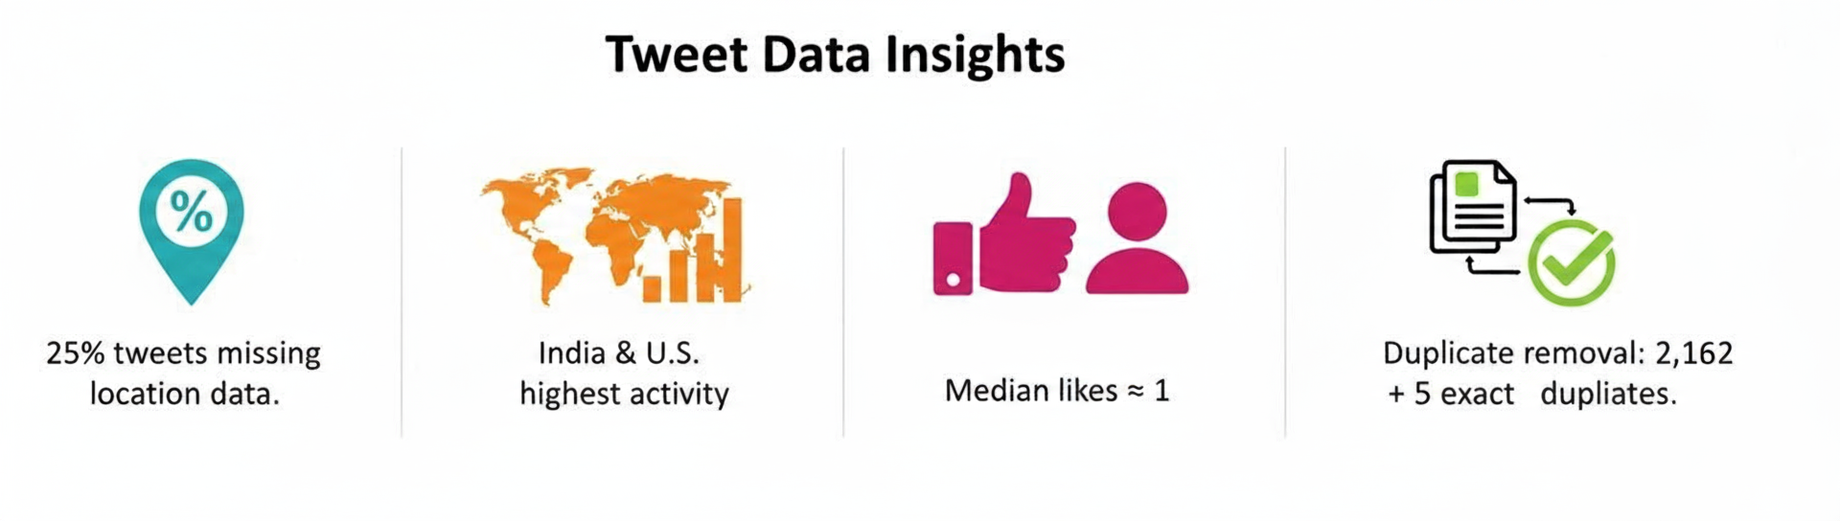
Exploratory Data Analysis (EDA)
25% tweets missing location data.
India & U.S. show highest tweet activity.
Median likes ≈ 1, indicating broad user participation.
Duplicate removal: 2,162 entries + 5 exact duplicates.

Slide 7
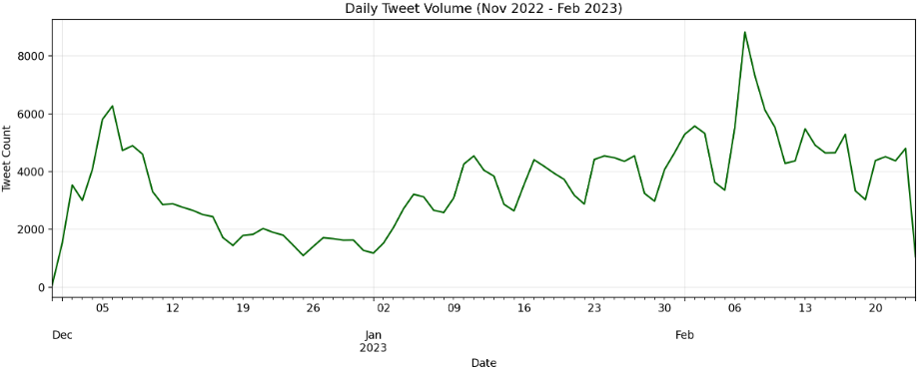
Temporal Trends
Sharp increase in December 2022 after ChatGPT release.
Sustained engagement of 3k–6k tweets/day.
Gradual normalization by late February 2023.

Slide 8
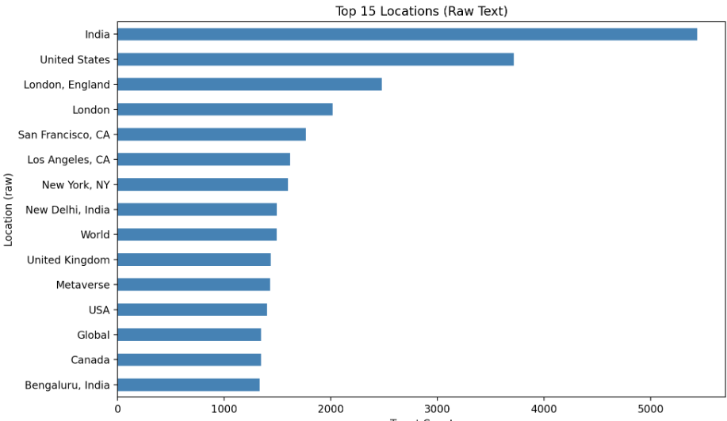
Language & Location Distribution
99.2% English (302,919 tweets).
Remaining < 1%: French, German, Dutch, Indonesian, others.
Top locations: India, U.S., London.
Missing locations: ~76k entries filled via geocoding.

Slide 9
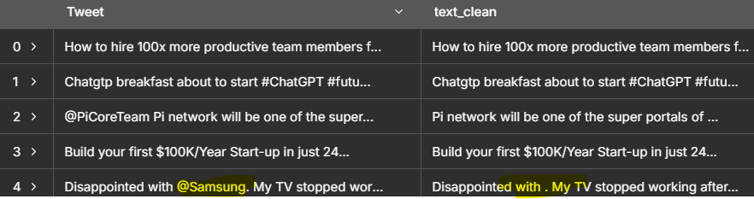
Data Cleaning & Preprocessing
Removed URLs and @mentions; kept hashtags & emojis.
Lowercased text and removed stopwords (NLTK).
Standardized timestamps.
Added derived features (time of day, week, etc.).

Slide 10
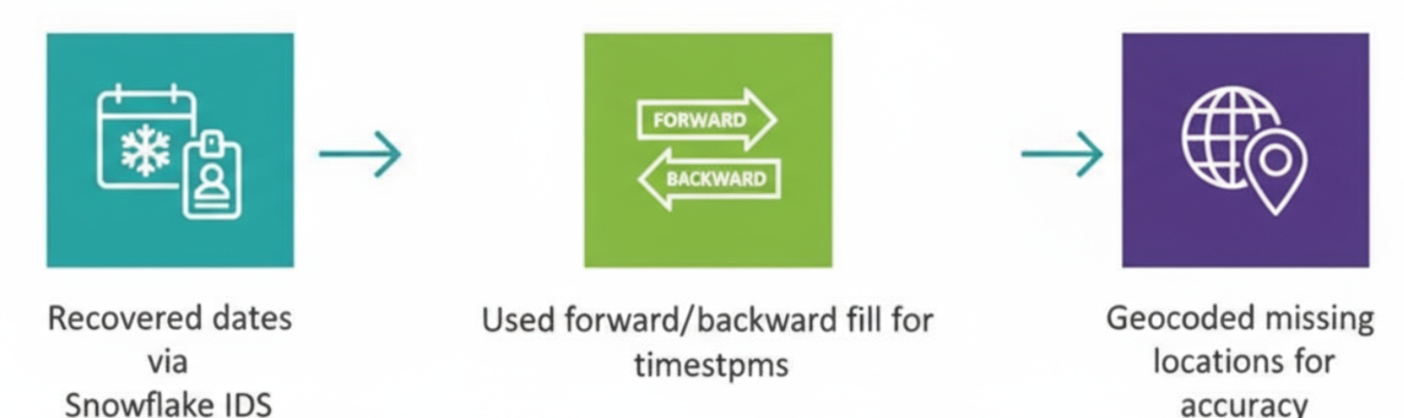
Handling Missing Values
Recovered dates via Snowflake IDs
Used forward/backward fill for timestamps.
Geocoded missing locations for accuracy.

Slide 11
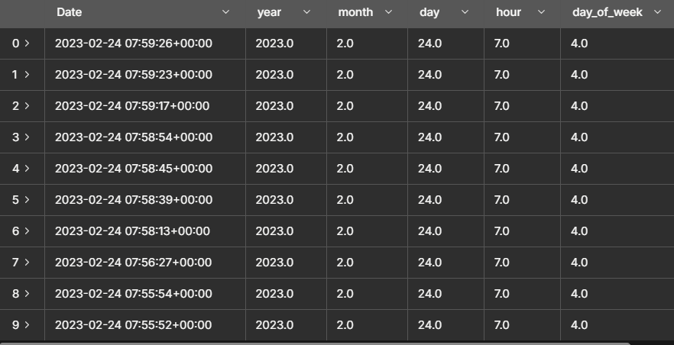
Parse and standardize created_at timestamps
We parsed the tweet timestamp and the account creation date in UTC format.
From the Date, we extracted several time-related features, including the year, month, day, hour, day of the week (with Monday as 0), and an indicator for weekends (where Saturday and Sunday are marked as 1).
All of these adjustments were made directly within the existing dataframe to keep the integrity of the data intact.

Slide 12
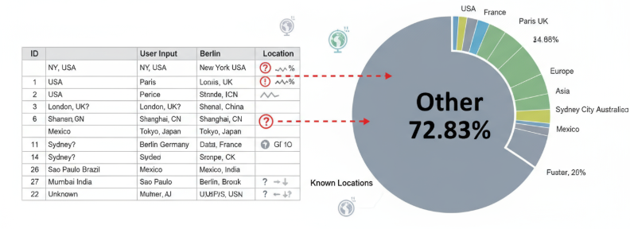
Challenge Encountered 🤯
A total of 2,22,435 rows about 72.83% of the dataset were classified as “Other” under the Location field.
This category includes records where the location text could be parsed to a city, region, or state, but the country could not be confidently identified.
The issue arose mainly due to ambiguous, incomplete, or inconsistently formatted location inputs provided by users.

Slide 13
How We Tackled The Problem
Expanded city-to-country lookup table (e.g., London → United Kingdom, New York → United States).
Integrated geocoding API to resolve ambiguous or incomplete city/region names (rate-limited).
Standardized punctuation and suffix variants (e.g., “UK.” → “United Kingdom”).
Applied probabilistic disambiguation for common city-state pairs (e.g., “California, USA” → United States).

Slide 14
How We Tackled The Problem
Reduced “Other + Unknown” share from 72.83% → 65.7% (↓ 7.13 pp).
Reclassified 21,780 rows from “Other” to specific countries.
Enhanced geocoding accuracy through normalization and disambiguation of city/state inputs.
Improved overall geographic coverage, strengthening region-level sentiment insights.
Achieved our targeted acceptance criteria of less than 45% through multiple rounds of refinement and heuristic optimization, demonstrating continuous improvement and effective problem-solving. 🥳

Slide 15
Linear Regression
Model Setup
Target: log-transformed likes (log(1 + likes)) to handle skewness
Algorithm: Ridge regression (L2 regularization, alpha=1.0)
Train/test split: Trained on data before Feb 1, 2023; tested on Feb 1-24, 2023
Features Used
User metrics: log(followers), log(friends), verified status, account age
Tweet characteristics: length, number of hashtags, number of mentions
Temporal: hour of day, day of week, weekend indicator
Categorical: language (one-hot encoded), country (one-hot encoded)
Performance
R² on test set (log-likes): 0.1468 (14.7% variance explained)
R² on test set (raw likes): 0.0019 (near zero after back-transform)
MAE ≈ 1,911 tweets/day
RMSE ≈ 2,268 tweets/day
Interpretation: Model captures moderate linear signal in log space but struggles with raw engagement due to high skewness
Key Insights
Follower count and verification status show positive linear relationship with engagement
Time-of-day and day-of-week patterns contribute to predictions
High variance in tweet engagement limits linear model effectiveness
Exponential back-transformation amplifies prediction errors, especially for viral tweets

Slide 16
Time Series Forecasting
Data & Aggregation
Aggregated tweets to daily counts over the dataset window.
Engineered exogenous features:
Day-of-week one-hot to capture weekly seasonality
7-day rolling mean for short-term momentum
Model
SARIMAX with exogenous regressors
Order: (1,1,1)
Seasonal order: (1,1,1, 7) for weekly seasonality
Exogenous: day-of-week dummies + 7-day rolling mean
Train/Test split:
Train through 2023-02-10
Test window 2023-02-11 to 2023-02-24 (14 days)
Practical Insights
Weekly seasonality is a strong driver of daily volume
Momentum (7-day rolling mean) improves short-horizon stability
Including event/holiday indicators can further enhance spikes handling

Slide 17
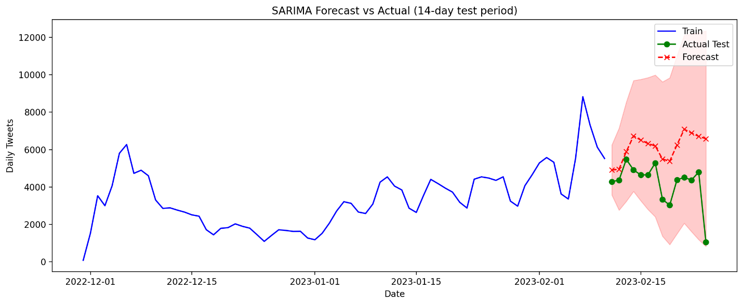
Time Series Forecasting

Slide 18
Sentiment Analysis
Why we choose VADER:
We used the tweet_clean VADER (NLTK) as the baseline tool.
VADER is a rule-based sentiment analyzer designed specifically for social media text, making it ideal for tweets.
It uses a predefined lexicon to assign positive, negative, and neutral scores effectively handling slang, emojis, and abbreviations.
What we did:
Identified the Tweet column as the main text source and ensured complete, non-null data coverage.
Applied NLTK VADER to all tweets to generate sentiment labels and scores (positive, neutral, negative, and compound values).

Slide 19
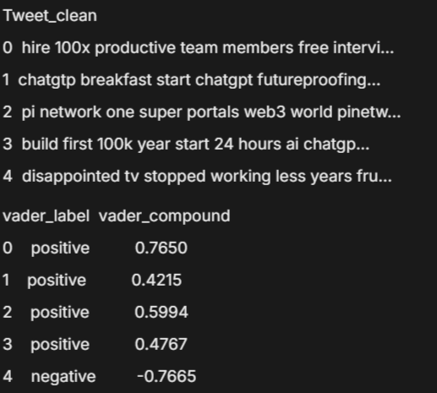
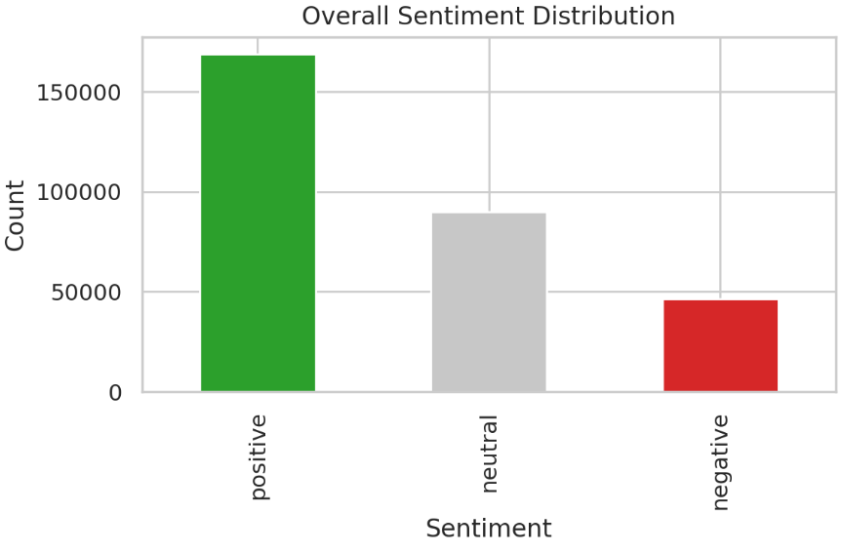
Sentiment Analysis

Slide 20
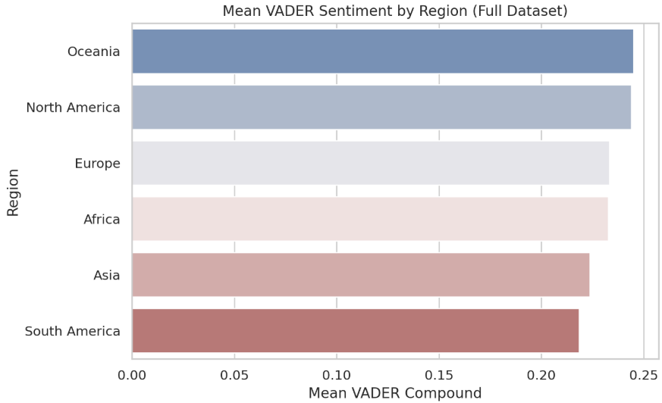
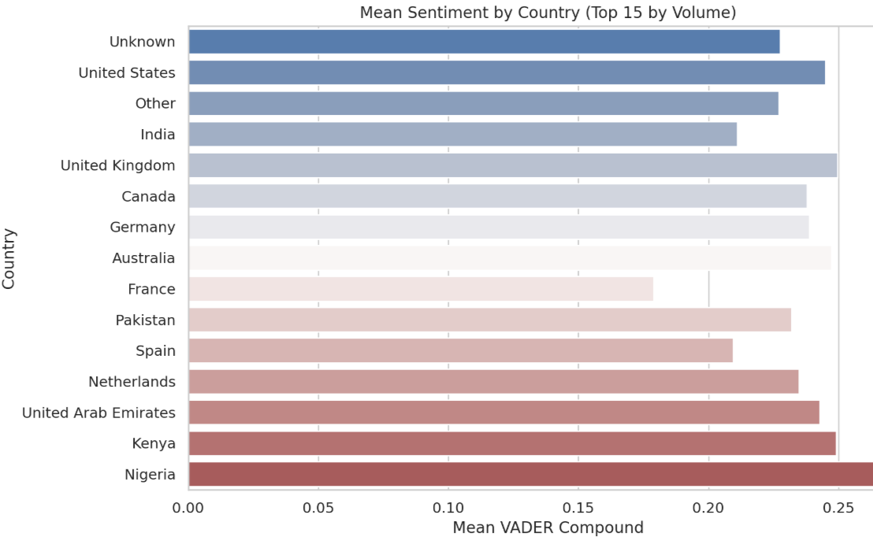
Mean Sentiment By Region & Location

Slide 21
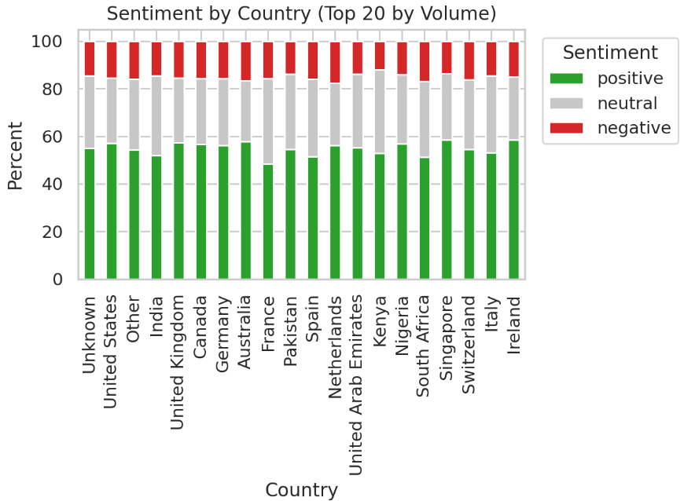
Stacked bar chart: Top 20 countries by volume

Slide 22
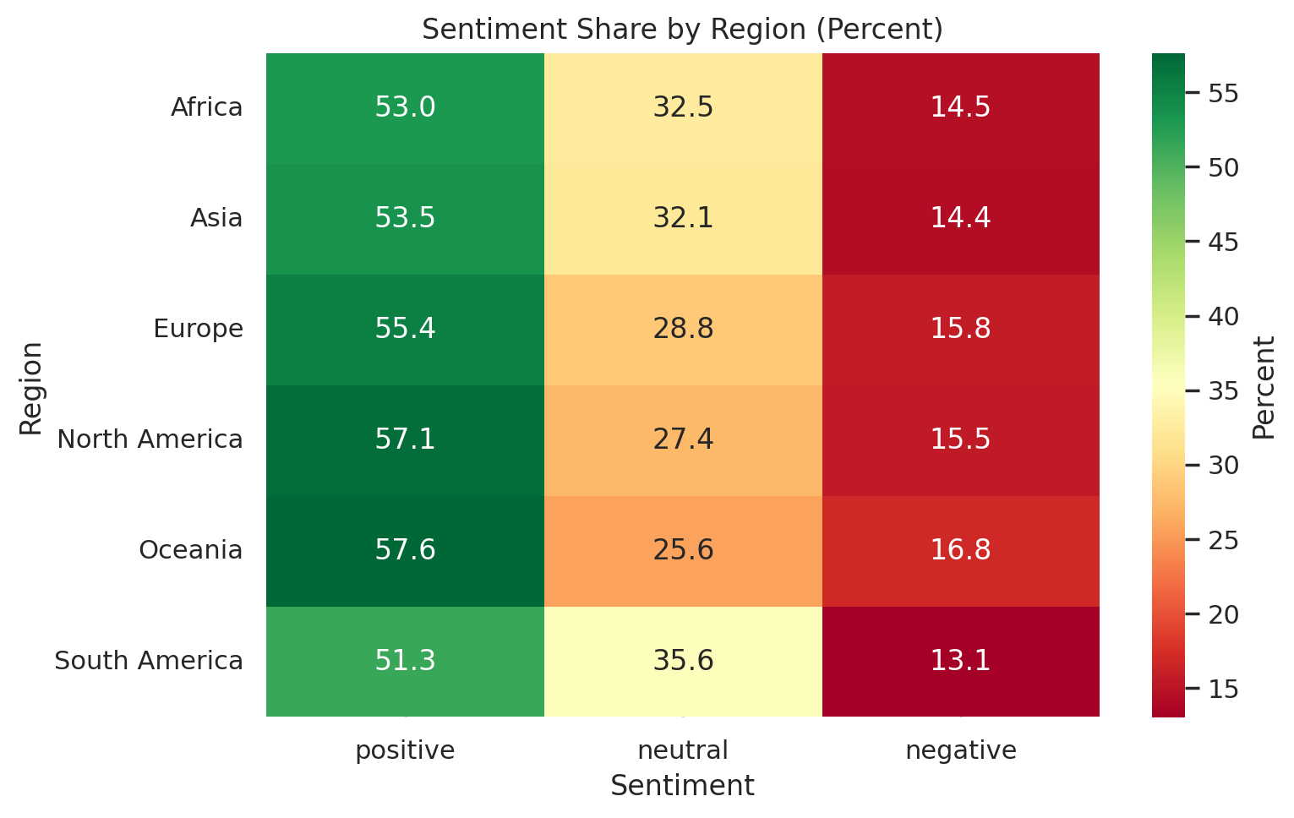
Heatmap: Sentiment share by region

Slide 23
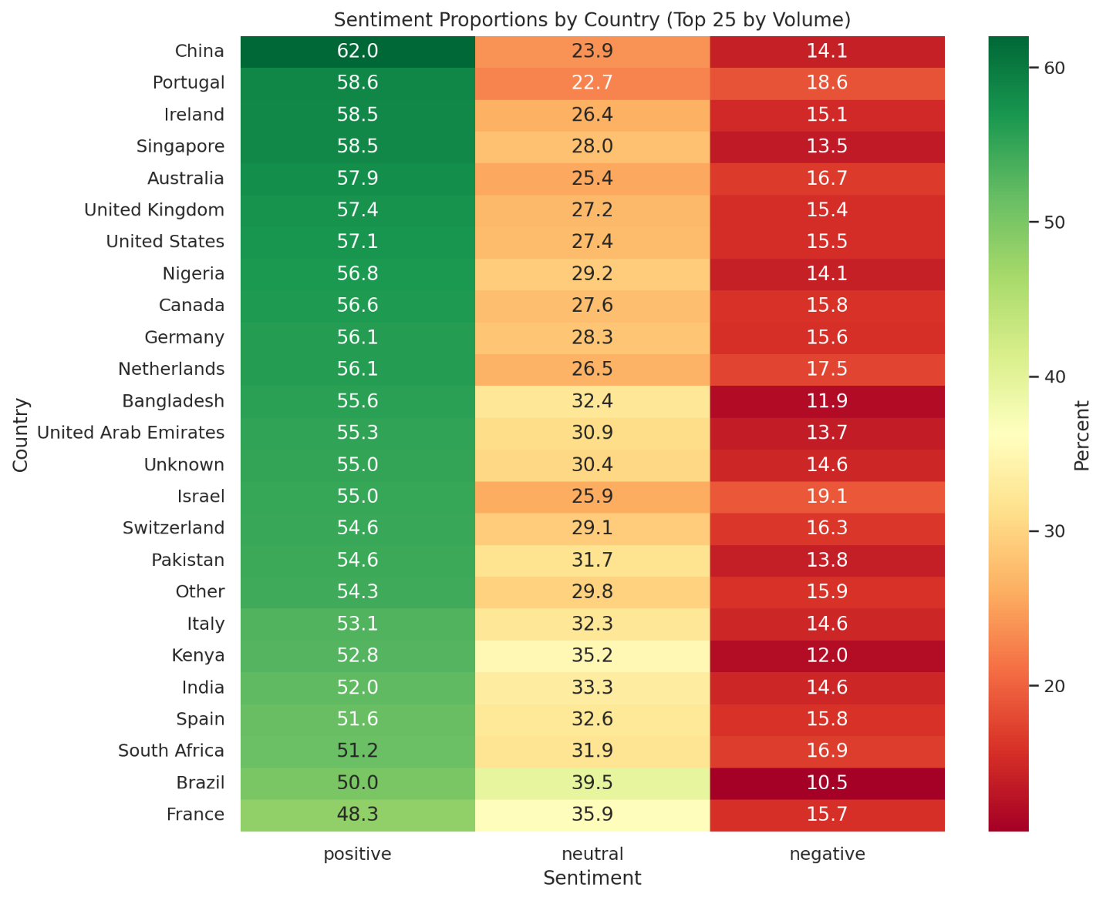
Heatmap: Sentiment proportions across top locations

Slide 24
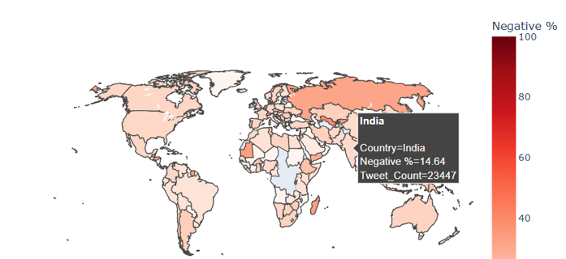
Negative sentiment by location

Slide 25
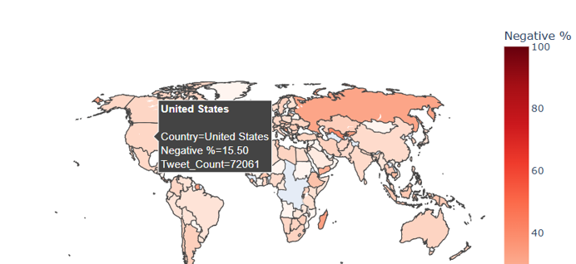
Negative sentiment by location

Slide 26
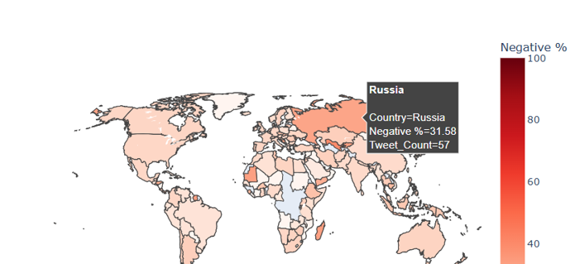
Negative sentiment by location

Slide 27
Key Findings
South America: Largest decline (-0.052); sentiment dropped from 0.249 to 0.197, reflecting increased skepticism about AI.
Oceania: Decline (-0.022) from 0.272 to 0.250; concerns emerging despite historically positive sentiment.
North America: Decline (-0.022) from 0.259 to 0.237; rise in caution/criticism in a high-volume market.
Asia: Decline (-0.022) from 0.237 to 0.215; likely due to regulatory and competitive pressures.
Europe: Slight decline (-0.012) from 0.241 to 0.229; aligns with ongoing regulatory discussions (EU AI Act).
Africa: Stable (+0.001) at ~0.24; sentiment remains balanced and steady.

Slide 28
Policy Implications
The significant decline in sentiment in South America calls for an examination of local AI adoption barriers, misinformation, or economic issues.
The consistently low sentiment for Bard indicates that Google could be experiencing trust deficits; regulators ought to keep an eye on competitive practices and transparency.
Concerns regarding cybersecurity are widespread; it is essential for policymakers to give precedence to standards for AI security and frameworks for incident response.
The negative sentiment surrounding #teaching in North America indicates concern about AI's involvement in education, highlighting the necessity for proactive teacher training and ethical guidelines.

Slide 29
RECOMMENDED MONITORING ACTIONS:
Automate sentiment monitoring for AI discussions in key regions; integrate with threat intelligence for timely detection of backlash and misinformation.
Conduct bi-weekly and quarterly reviews of AI product mentions (Bard, Gemini, ChatGPT) to identify drivers of negative sentiment, emerging risks, and problematic hashtags for cross-sector response.

Slide 30
Conclusion
There are indications of stress in global AI sentiment, especially in South America, Oceania, and North America. Discussions about Bard/Gemini and cybersecurity are vital areas of focus. To sustain public trust and guarantee responsible AI development, it is crucial to engage regionally, communicate transparently, and monitor proactively.

Slide 31

Thank You / Q&A
We welcome your questions and feedback.

